Slide 1
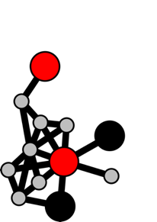

Functional annotation lesson
HMM-based annotation:
FeGenie introduction and tutorial

Slide 2
Artwork: Nancy Merino

Slide 3
What is FeGenie
A collection of HMMs, based on a comprensive set of genetic markers related to iron acquisition/scavenging, transport, efflux, storage, as well as iron redox (dissimilatory reduction and oxidation)
A bioinformatics software that uses these HMMs to profile genomic datasets (in FASTA format)
Uses rules for filtering out potential false positives (operon structure, genetic co-occurance, bit scores)

Slide 4
Bolded and underlined genes represent HMMs taken from Pfam and TIGRFAMs
Others were designed specifically for FeGenie

Slide 5
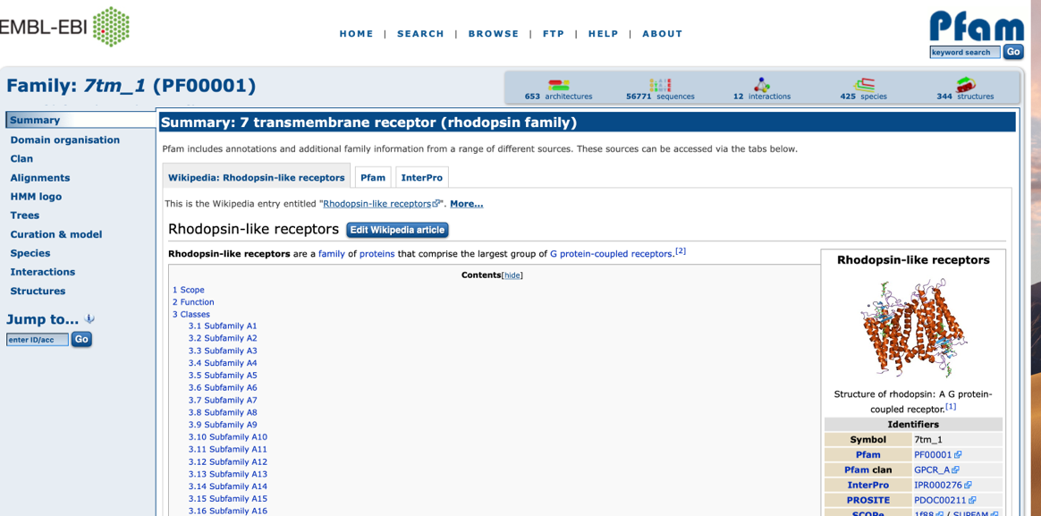
Getting HMMs from Pfam

Slide 6
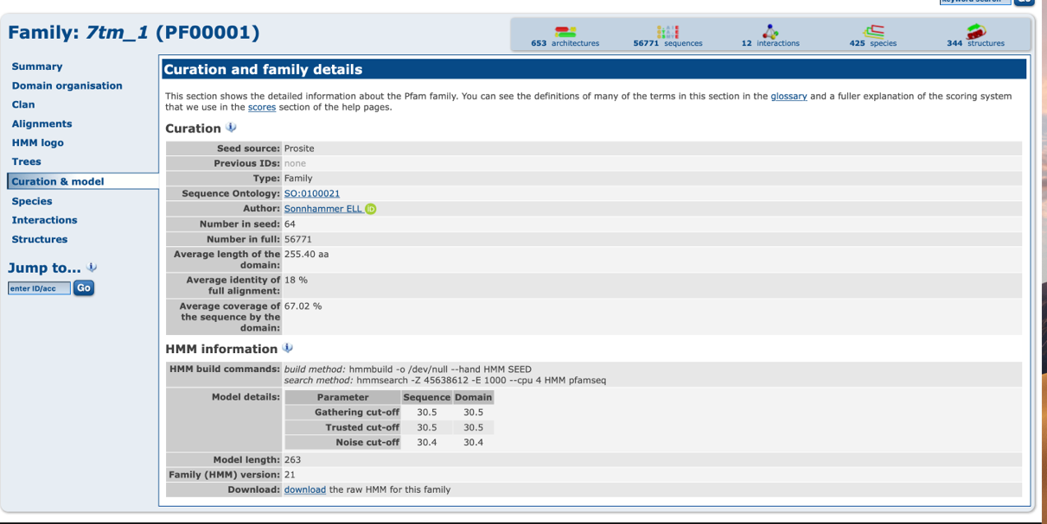
Getting HMMs from Pfam

Slide 7
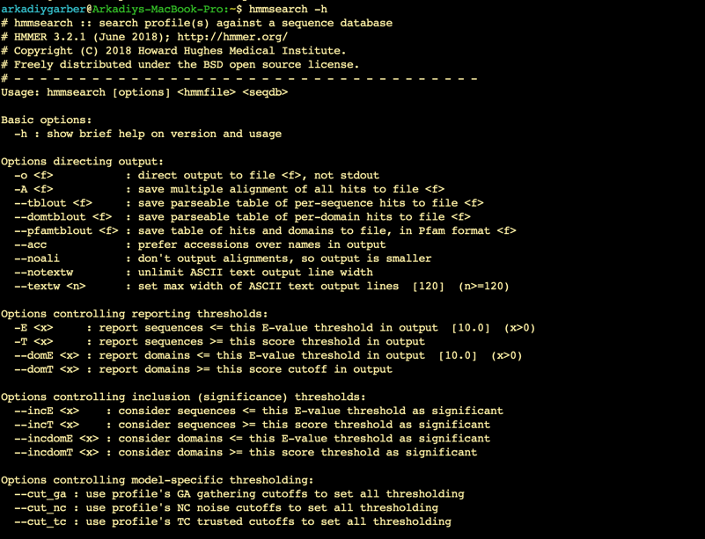
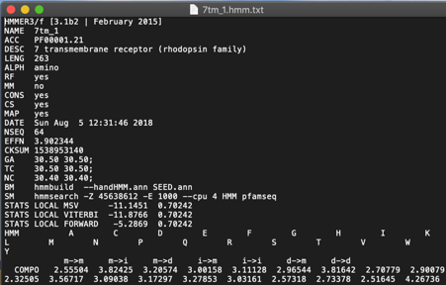
Getting HMMs from Pfam

Slide 8
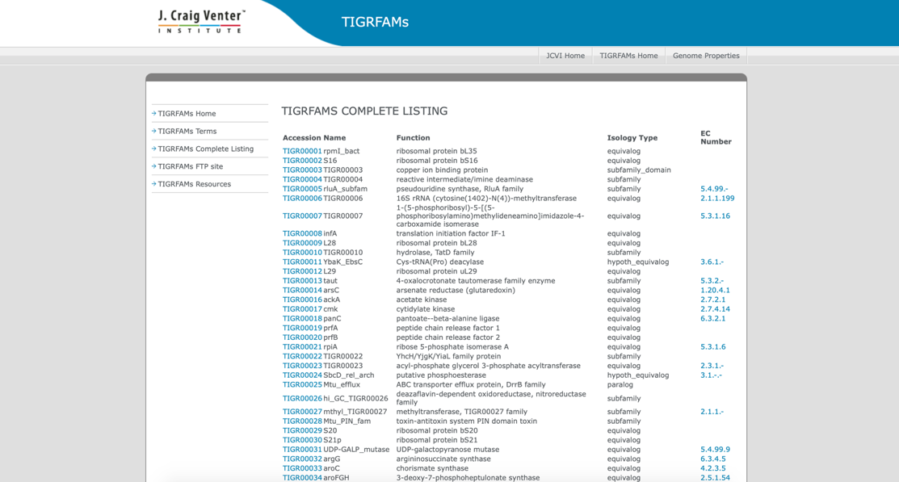
Getting HMMs from TIGRFAMS

Slide 9
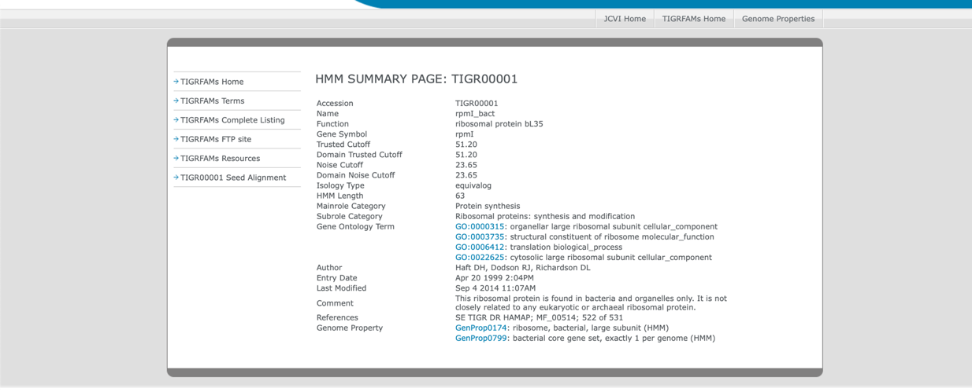
Getting HMMs from TIGRFAMS

Slide 10
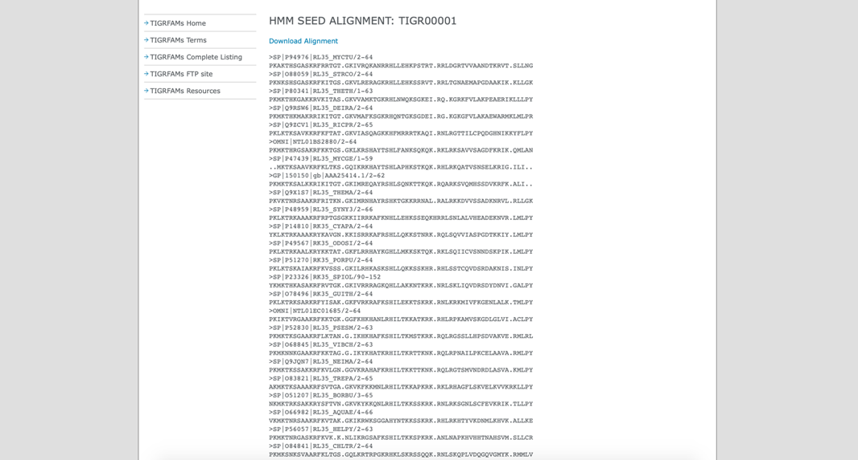
Getting HMMs from TIGRFAMS

Slide 11
Bolded and underlined genes represent HMMs taken from Pfam and TIGRFAMs
Others were designed specifically for FeGenie

Slide 12
Summary of iron acquisition, efflux, and storage strategies in bacteria
Iron acquisition/scavanging strategies very improtant in iron-limiting enviornments like the open ocean

Slide 13
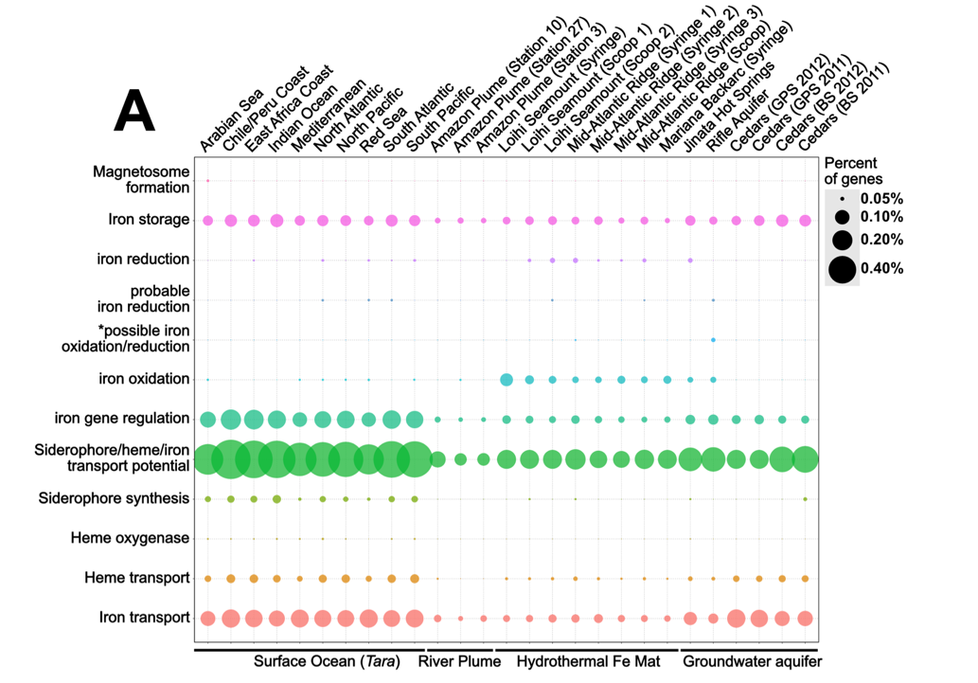

Slide 14
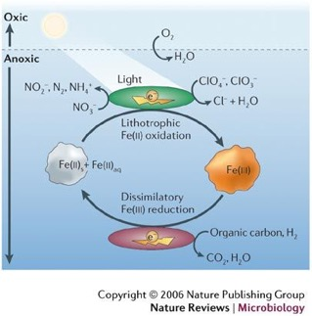
Iron oxidation and reduction – porin-cytochrome modules are key players in iron-related redox reactions in gram-negative bacteria
S-layer and cytoplasmic membrane associated proteins are used by gram-positive bacteria and Archaea

Slide 15
General workflow involves a combination of custom scripts and other bioinformatics software for ORF-prediction and HMM-based homology searching.

Slide 17
Jupyter Binder tutorial

